Slide 1
THE PRESUMPTION
OF PSEUDOSCIENCE
In defense of electrochemists Martin Fleischmann and Stanley Pons, and cold fusion, of course!
On motives of the publications in Russian mass media.
Sergei A. Tcvetkov
Kurchatov str. 4-13, Zarechny, Sverdlovsk region, 624250, Russia
E-mail: rossomahi@gmail.com
As the epigraph I would like to give the verse and the words of two truly Russians in literature and science:
So the false wisdom is shimmers and smolders
Before the sun of the immortal mind.
Long live the sun, yes will disappear darkness!
Alexander Pushkin, (Bacchus song: “Joy fell silent merriment the voice?”)
and
...how much else needs to know, and how with the help of science without violence, lovingly, but firmly, eliminated prejudices and errors, and achieved: protection produced true, freedom for further development, the common good and internal well-being.
Dmitry I. Mendeleev (from the dedication of the mother for his work “Investigation of aqueous solutions by specific gravity”. 1887).

Slide 2

THE PRESUMPTION
OF PSEUDOSCIENCE
The history of the beginning and continuation of cold nuclear fusion in its own way tragic and instructive and every story she's like no other and can be attributed to the experience of future generations. Their attitude toward cold fusion I would formulate so: If cold fusion did not exist, it would be worth to think of.
Acting as a direct participant in many of these events I have to say that the farther from the beginning of the cold nuclear fusion, the more imagination, transitions into the category of myth-making, violent perversion of facts, forgeries and unhealthy mockery of the authorities in the media and on the Internet.
Sometimes it comes to outright lies. Need something to do! I am for historical justice and truth. Because: really is not the search for and preservation of truth the primary task of science? There is always the availability of freedom degrees multiple views on event – this is my insider’s view.
Here are some examples of publications and statements on TV in Russia for the last time.
(Below in cursive is a lie, a bold font - explicit lie.)
In "Popular mechanic" №8, 2011 in paper "Cold fusion: myth and reality" Alexey Levin
writes that "Massachusetts Institute of Technology’s Staffers tried to reproduce the
experiments of M. Fleischmann and S. Pons, but again to no avail.
It is therefore not surprising that the demand for the great discovery had undergone a
crushing defeat at the conference of the American Physical Society (APS), which met in
Baltimore 1 May of that year."
Sergei A. Tcvetkov

Slide 3
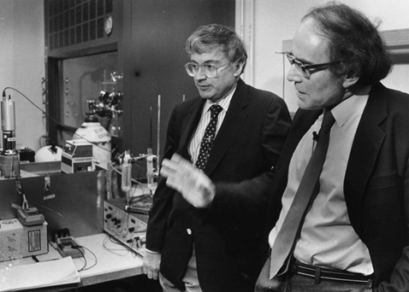
THE PRESUMPTION
OF PSEUDOSCIENCE
Creeping cold fusion.
Author: Evgeny Tsygankov 08.12.2016.
Cold fusion? A little look at the history.
The date of birth of cold fusion can be considered in 1989. Then, in the English-language press was published information about a report by Martin Fleischmann and Stanley Pons, in which it was stated that nuclear fusion was carried out in the following installation: a current passes through palladium electrodes dipped in heavy water (with two deuterium atoms instead of hydrogen, D₂O), as a result of which one of the electrodes melts.
Stanley Pons (left) and Martin Fleischmann (right).
Fleishman and Pons give this interpretation of what is happening: the electrode melts as a result of the release of too much energy, the source of which is the fusion reaction of deuterium nuclei. Nuclear fusion, therefore, supposedly takes place at room temperature. Journalists called the phenomenon "cold fusion", in the Russian version, cold fusion became for some reason "cold thermonuclear", although the phrase contains a clear internal contradiction. If in some media the newfound cold fusion could be met with warmth, then in the scientific community the statement of Fleishman and Pons was treated very coolly. At an international meeting less than a month later, to which Martin Fleischmann was also invited, the statement was critically reviewed.

Slide 4
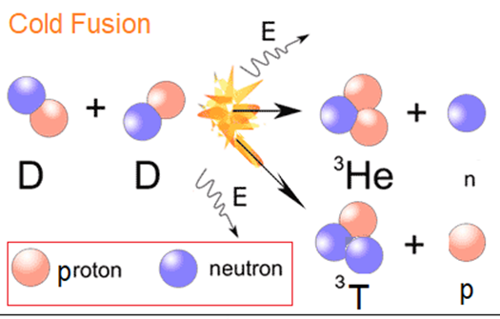
THE PRESUMPTION
OF PSEUDOSCIENCE
The simplest considerations pointed to the impossibility of nuclear fusion occurring in such a facility. For example, in the case of the d + d → ³He + n reaction, for the powers discussed in the Pons and Fleischmann setup, there would be a neutron flux that would provide the experimenter with a lethal dose of radiation within an hour. The presence of Martin Fleischmann himself at the meeting directly pointed to the falsification of the results. Nevertheless, in a number of laboratories, similar experiments were conducted, according to the
results of which no products of nuclear fusion reactions were found. However, this did not prevent one sensation from giving rise to an entire community of cold fusion adherents, which functions according to its own rules to this day.
In the program "Meanwhile" with Alexander Arkhangelsky "Pseudoscience: the endless struggle?" on the channel Culture of Russian TV at the end of October 2016, it is said that:
"The Presidium of the Russian Academy of Sciences has approved the new composition of the Commission on Combating Pseudoscience and Falsification of Scientific Research. Now it consists of 59 scientists, including physicists, biologists, astronomers, mathematicians, chemists, representatives of humanitarian specialties and specialists in agriculture. When Academician Vitaly Ginzburg initiated the creation of the commission in 1998, pseudoscientific concepts particularly annoyed physicists and engineers. Back then, fantasies about new sources of energy and overcoming basic physical laws were popular. The Commission has consistently defeated the teachings on torsion fields, cold nuclear fusion, and anti-gravity. The most high-profile case was the exposure in 2010 of Viktor Petrik's invention of nanofilters for cleaning radioactive water…»

Slide 5

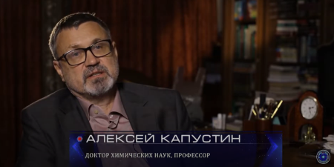
THE PRESUMPTION
OF PSEUDOSCIENCE
"Huge damage to thermonuclear fusion is caused by constantly appearing reports about the so-called cold nuclear fusion, that is, a synthesis that takes place not at millions of degrees, but, say, at room temperature on a laboratory table. The message from 1989 that new elements had been produced during electrolysis on palladium catalysts, that hydrogen atoms had merged into helium atoms - it was like a kind of information explosion.
Yes, the discovery, in quotation marks, the "discovery" of these scientists was not confirmed by anything. This damages the reputation of thermonuclear fusion also because the business easily responds to these strange scandalous requests, hoping for a quick easy profit, it subsidizes start-ups dedicated to cold fusion. None of them were confirmed. This is an absolute pseudoscience, but, unfortunately, it is very harmful to the development of real thermonuclear fusion. "These are the words of an expert, Doctor of Chemical Sciences, Professor Alexey Kapustin in the TV program of the NTV channel "We and science, science and we. Controlled thermonuclear reaction" from 26.11.2016.
Fusion: the miracle that happens.
January 9, 2017 Denis Strigun.
https://naked-science.ru/article/sci/termoyadernyy-sintez-chudo-kotoroe.
Cold nuclear fusion.
No matter how tiny it was, the chance to hit the jackpot in the "thermonuclear" lottery excited everyone, not just physicists. In March 1989, two fairly well-known chemists, the American Stanley Pons and the British Martin Fleishman, gathered journalists to show the world "cold" nuclear fusion. It worked like this. A palladium electrode was placed in a solution with deuterium and lithium and a direct current was passed through it.

Slide 6

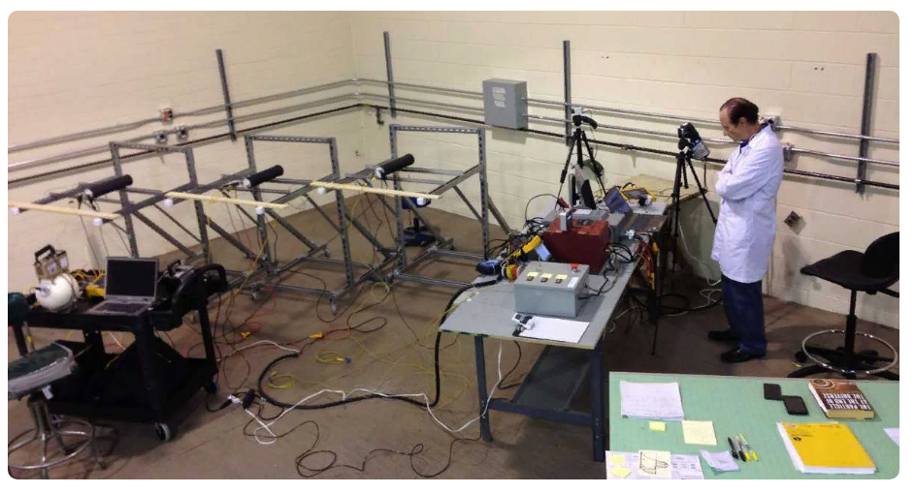
THE PRESUMPTION
OF PSEUDOSCIENCE
Deuterium and lithium were absorbed by palladium and, when they collided, sometimes "linked" into tritium and helium-4, suddenly heating the solution sharply. And this is at room temperature and normal atmospheric pressure.
First, details of the experiment appeared in The Journal of Electroanalytical Chemistry and Interfacial Electrochemistry only in April, a month after the press conference.
It was contrary to scientific etiquette.
Secondly, the nuclear physicists had many questions for Fleischmann and Pons. For example, why in their reactor does the collision of two deuterons give tritium and helium-4, when it should give tritium and a proton or a neutron and helium-3? Moreover, it was easy to verify this: provided that nuclear fusion took place in the palladium electrode, neutrons with a pre-known kinetic energy would "fly off" from the isotopes. But neither the neutron sensors nor the reproduction of the experiment by other scientists led to such results. And due to a lack of data, in May, the sensation of chemists was recognized as a "duck".
Andrea Rossi during the tests of the device for the " low-energy nuclear reaction»

Slide 7
THE PRESUMPTION
OF PSEUDOSCIENCE
So, let us formulate the claims on which the refusal of the public is based on the recognition of the discovery of the phenomenon of cold nuclear fusion by M. Fleishman and S. Pons. And note, it is the claims, and not the arguments and evidence against this phenomenon, based on the doubts of the so-called "experts", who have never been engaged in the repetition and verification of this phenomenon.
First; a press conference before the publication of an paper in a scientific journal-ay-ay-ay! not good: violation of scientific ethics!
Second: What are you doing? This can't be happening! We've been struggling with thermonuclear fusion for decades and we can't get any excess heat at hundreds of millions of degrees in the plasma, and you're telling us about room temperature and MegaJoules of heat in excess of the energy invested? Nonsense!
Third: Even if it is, you all should have died a long time ago!
Fourth: Vaughn at Caltech (California Institute of Technology) and at MIT (Massachusetts Institute of Technology) it doesn't work. You're all lying!
Fifth: They also want to ask for money to continue these works? And from whom will this money be taken away?
Sixth: This will not happen while we are alive! Drive S. Pons out of the university and the USA!
I must say that the same scenario was tried in the early 2000s with a professor at Purdue University, Ruzi Taleyarkhan, for his bubble "thermonuclear", but the case went to court and the professor was reinstated in his rights and positions.

Slide 8

THE PRESUMPTION
OF PSEUDOSCIENCE
A few words about a purely Russian invention in science about the
COMMISSION ON COMBATING PSEUDOSCIENCE AND
FALSIFICATION OF SCIENTIFIC RESEARCH under the Presidium of
the Russian Academy of Sciences, as they call themselves. The
Commission on Pseudoscience has already hung up a medal for itself.
“… for the consistent destruction of torsion fields, cold nuclear fusion, and anti-gravity." The "chain dogs of budget money" have completely dissolved, there is no one to flog them. Apparently, they believe that the cries about not giving money to these ignoramuses and adventurers in the Conferences and Symposiums section of the journal Advances in Physical Sciences volume 169 No. 6 for 1999, is the defeat of cold nuclear fusion? This is a strange way of conducting a scientific discussion, especially after instructions were sent out to the editorial offices of Russian scientific journals forbidding the publication of scientific papers that even once mention the words cold nuclear fusion.
The author has a sad experience of trying to publish the results of his research in at least two Russian academic journals. Let's hope that the leadership of the Russian Academy of Sciences will finally collect the last remnants of the brains leaking from the country and reconsider its attitude to science as a development, and not a degradation of society.
It will finally close the shameful page of Russian science in the form of the Commission on Pseudoscience and stop wasting time and money on bans and obstacles for idlers from science.

Slide 9
THE PRESUMPTION
OF PSEUDOSCIENCE
The price of the question?
Before we deal with these claims, we will try to evaluate the advantages of nuclear fusion over other methods of generating energy known at the moment. Take the amount of released energy per gram of reacting substance. It is the reacting substance, and not the material in which these reactions occur.
To begin with, let's look at the table of the amount of energy released per gram of the reacting substance for different methods of energy production and perform simple arithmetic operations, comparing these amounts of energy.
This data can be obtained from [1] and presented as a table:
The way to get energy | kWh/kg | J/g | Times greater than previous row energy
Burning oil (coal) | 11.6 | 42 kJ/g | 1
In the fission of uranium-235 | 22.9 x 10⁶ | 82.4 GJ/g | 1,974,138
In the fusion of hydrogen nuclei | 117.5 x 10⁶ | 423 GJ/g | 5
The energy of a substance according to the formula E=mc² | 29 x 10⁹ | 104.4 TJ/g | 247

Slide 10
THE PRESUMPTION
OF PSEUDOSCIENCE
The way to get energy | kWh/kg | J/g | Times greater than previous row energy
Burning oil (coal) | 11.6 | 42 kJ/g | 1
In the fission of uranium-235 | 22.9 x 10⁶ | 82.4 GJ/g | 1,974,138
In the fusion of hydrogen nuclei | 117.5 x 10⁶ | 423 GJ/g | 5
The energy of a substance according to the formula E=mc² | 29 x 10⁹ | 104.4 TJ/g | 247
It turns out that when burning oil or high-quality coal, you can get 42 kJ/g of thermal energy. During the fission of uranium 235, 82.4 GJ/g of heat is already released, during the synthesis of hydrogen nuclei, 423 GJ/g will be released, and according to the theory, 1 gram of any substance can give up to 104.4 TJ/g of energy with full release (k is a kilo = 10³, G-Giga = 10⁹, T-Tera = 10¹²). It follows that one gram of deuterium can become a continuous heat source with a capacity of 3 kW for a whole year!
And immediately the question: "Is it necessary to engage in the extraction of energy from water?" for any sane person disappears by itself. There is a strong suspicion that, having mastered the method of obtaining energy in the fusion of hydrogen nuclei, we will only have one step left to completely release the energy of matter according to the famous formula E=m·c²!

Slide 11

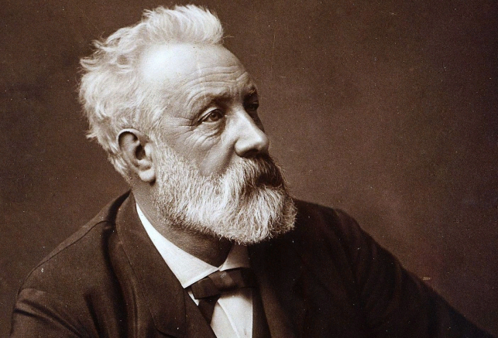
THE PRESUMPTION
OF PSEUDOSCIENCE
Italian Andrea Rossi showed that for cold nuclear fusion, you can use simple hydrogen, which is available in inexhaustible quantities on the planet Earth, and in space.
This opens up even more opportunities for energy, and the words of the French science fiction writer Jules Verne in his work "The Mysterious Island", published in 1874, become prophetic:
Andrea Rossi
"...I think that water will one day be used as fuel, and that the hydrogen and oxygen that are part of it will be used together or separately and will be an inexhaustible source of light and heat, much more intense than coal. ...I think that when the coal deposits are depleted, humanity will be heated and warmed by water. Water is the coal of the future."
Jules Verne
I put three exclamation marks to the great science fiction writer!!!
It is worth noting that by extracting hydrogen for cold nuclear fusion from water, humanity will receive oxygen necessary for breathing as a bonus.

Slide 12
THE PRESUMPTION
OF PSEUDOSCIENCE
Cold nuclear fusion or low-energy nuclear reactions? Cold fusion or LENR?
At the end of the 90s, the defeated remnants of scientists who, out of their own curiosity, secretly continued to repeat the experiments of M. Fleishman and S. Pons, decided to hide from the furious attacks of the "tokomafia" and the Commission established in Russia to Combat Pseudoscience at the Russian Academy of Sciences and engaged in low-energy nuclear reactions.
Renaming cold fusion as low-energy nuclear reactions is, of course, a weakness. This is an attempt to hide, so as not to be destroyed, this is a manifestation of the instinct of self-preservation. All this shows the severity of the threat not only to the profession, but also to the very life of such researchers.
Italian Andrea Rossi understands that his activities to promote his Energy Catalyst (E-cat) pose a threat to his life. Therefore, his actions seem illogical to many. But that's how he defends himself. I saw for the first time, and perhaps for the only time, in Zurich in 2012, how a person who is engaged in the development and implementation of a new energy technology entered a meeting of scientists and engineers accompanied by a bodyguard wearing a bulletproof vest.
The pressure from academic groups in science is so strong and aggressive that only completely independent people, such as pensioners, can now engage in cold synthesis. The rest of those interested are simply squeezed out of laboratories and universities. This trend was clearly visible in the world of science until recently and only last year the European Commission finally began timidly funding two projects on cold fusion, calling it the clean energy of hydrogen in metals. In 2019, the journal Nature, after 30 years of silence, published a controversial paper with two editorial comments. Although no outstanding results were obtained in the two-year studies, this paper brought the term cold fusion back to the pages of scientific journals and gave an impetus to a new beginning of publications on the topic of cold fusion in peer-reviewed journals.

Slide 13

THE PRESUMPTION
OF PSEUDOSCIENCE
Details of the opening.
Let's get back to our electrochemists. I would like to briefly recall the content of a scientific paper by M. Fleishman and S. Pons in a peer-reviewed journal with specific results. This information is taken from the abstract journal of the All-Union Institute of Scientific and Technical Information (RZH VINITI) of the USSR Academy of Sciences, published since 1952 – a periodical scientific and informational publication that publishes abstracts, annotations and bibliographic descriptions of Russian domestic and foreign publications in the field of natural, exact and technical sciences, economics and medicine. Specifically, this is RJ 18B Nuclear Physics. -1989. -6. - ref.6B1. Electrochemically induced nuclear fusion of deuterium. / Fleischmann Martin, Pons Stanley / / J. of Elecroanal. Chem. -1989. - Vol. 261. - No. 2a. - pp. 301-308.
At the University of Utah (USA), an experiment was performed aimed at detecting the fact of nuclear reactions
under conditions where deuterium is embedded in the metal lattice of palladium, which means "an effective increase in the pressure that brings the deuterons closer together due to chemical forces", which contributes to an increase in the probability of quantum-mechanical tunneling of deuterons through the Coulomb barrier of the DD pair in the internodes of the palladium lattice. The electrolyte is a solution of 0.1 mol of LiOD in water of the composition 99.5% D₂O + 0.5% H₂O. Palladium (Pd) rods with a diameter of 1 ~ 8 mm and a length of 10 cm, wrapped with platinum wire (Pt-anode), were used as the cathode. The current density was varied in the range of 0.001÷1 A/cm² at the voltage at the electrodes of 12 V. Neutrons in the experiment were recorded in two ways. First, a scintillation detector, including a dosimeter with boron BF3 counters (efficiency 2×10⁻⁴ for neutrons of 2,5 MeV energy). Secondly, by the method of registering gamma-quanta, which are formed when a neutron is captured by a hydrogen nucleus of ordinary water surrounding an electrolytic cell, by the reaction:
The detector was the NaI (Tl) crystal, and the logger was an ND-6 multichannel amplitude analyzer. Background correction was performed by subtracting the spectrum obtained at a distance of 10 m from the water bath.

Slide 14
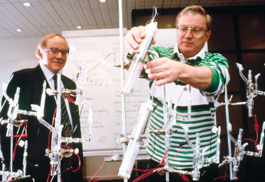
THE PRESUMPTION
OF PSEUDOSCIENCE
Tritons (T) were extracted from the electrolyte with using a special type of absorber (Parafilm’s film), and then their b-decay was recorded on a Beckman scintillation counter (45% efficiency). The best results were achieved on a Pd cathode with a diameter of 4 mm and a length of 10 cm at a current density through the electrolyzer of 0.064 A/cm². Neutron radiation with the intensity of 4×10⁴ neutrons/s, 3 times higher than the background, was recorded. The gamma-ray spectrum was found to have a maximum in the energy range of 2.2 MeV, and the gamma-ray counting rate was 2.1×10⁴ s⁻¹. The presence of tritium with a rate of formation of 2×10⁴ atoms/s was detected. In the process of electrolysis, a fourfold excess of the released energy over the total spent (electrical and chemical) energy was recorded. It reached 4 MJ/cm³ of the cathode in 120 h of the experiment. In the case of a 1×1×1 cm bulk Pd cathode, its partial melting was observed (T_{melts}=1554°C). Based on experimental data on tritium nuclei and gamma-quanta, the authors found the probability of a synthesis reaction to be 10⁻¹⁹ s⁻¹ per DD pair. At the same time, the authors note that if the main reason for the increased energy yield is considered to be nuclear reactions involving deuterons, then the neutron yield would be significantly higher (by 11÷14 orders of magnitude). According to the authors, in the case of electrolysis of the D₂O+DTO+T₂O solution, the heat release can increase to 10 kW/cm³ of the cathode.
A few words about scientific ethics, the violation of which is blamed on M. Fleishman and S. Pons. As it is clear from the original paper, it was received by the editorial board of the journal on March 13, 1989, accepted for publication on March 22, 1989, and published on April 10, 1989. And where is the violation of ethics, and most importantly by whom?
From this description, it is clearly and unambiguously clear that an incredibly huge amount of excess heat has been obtained, several times greater than the energy spent on electrolysis and the possible chemical energy that can be released by the simple chemical decomposition of water into individual atoms. The detected tritium and neutrons clearly indicate the process of nuclear fusion. Moreover, neutrons are registered in two independent ways by different devices.

Slide 15

THE PRESUMPTION
OF PSEUDOSCIENCE
In 1990, the following
paper was published in the
same journal: Fleischmann,
M., et al., Calorimetry of
the palladium-deuterium-
heavy water system. J. Electroanal. Chem., 1990, 287, p. 293, specifically related to the heat release in these studies, from which it can be seen from Figure 8A that the intense heat release, and therefore the effect itself, begins only on 66-th day (~5.65×10⁶ sec) CONTINUOUS operation of the electrolytic cell and continues for 5 days. That is, to get the result and fix it, it is necessary to spend SEVENTY-ONE DAYS on measurements, not counting the time for preparing and manufacturing the experimental setup. For example, it took us all of April to make the first installation, launch it, and perform various calibrations, and it was only in mid-May 1989 that we received the first results.
Fig. 8A. Cell temperature vs. time (upper) and cell potential vs. time (lower) plots for a 0.4 × 1.25 cm Pd rod electrode in 0.1 M LiOD solution.
Current density 64 mA cm⁻², bath temperature 29.87ºC.

Slide 16
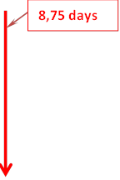
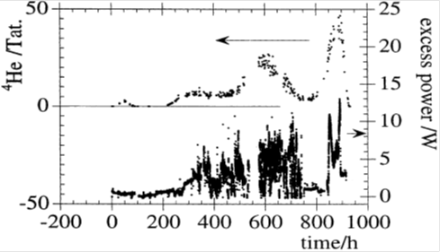
THE PRESUMPTION
OF PSEUDOSCIENCE
The beginning of the process of heat release during electrolysis with a large delay was subsequently confirmed by D. Gozzi, F. Cellucci, P. L. Cignini, G. Gigli, M. Tomellini, E. Cisbani, S. Frullani, G. M. Urciuoli, J. Electroanalyt. Chem. 452, p. 254, (1998). The beginning of a noticeable release of excess heat is registered here after 210 hours, which corresponds to 8.75 days and lasted for more than 30 days.
As well as Michael C. H. McKubre (Director of the Energy Research Center of the Stanford Research Institute, USA), who presented his results at the 10th International Conference on Cold Fusion (ICCF-10) on August 25, 2003. The beginning of the release of excess heat was in 520 hours, which corresponds to 21.67 days.

Slide 17
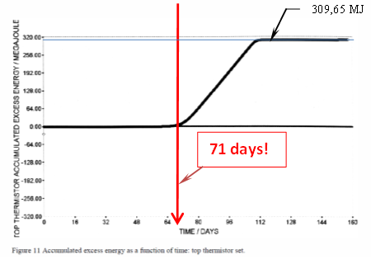
THE PRESUMPTION
OF PSEUDOSCIENCE
In their work in 1996, reported at the 6th International Conference on Cold Fusion (ICCF-6) by T. Roulette, J. Roulette, and S. Pons. Results of ICARUS 9 Experiments Run at IMRA Europe. IMRA Europe, S. A., Centre Scientifique Sophia Antipolis, 06560 Valbonne, FRANCE, Stanley Pons demonstrated two things. The first and perhaps most important thing is that, having moved from the United States in 1992 to the south of France in a new place after a considerable period of time, in another country, he was able not only to reproduce the experiment conducted in 1989 in Salt Lake City, but also to get great results on heat! What kind of non-reproducibility can we talk about here? See:
The second, according to these data, noticeable heat release begins on the 71st day of electrolysis! The change in heat release continues for more than 40 days and then constantly at the level of 310 MJ up to 160 days!
Therefore, how can we talk in a little more than a month about the non-reproducibility of the experiments of M. Fleishman and S. Pons in one single laboratory, which conducted the test not even on a scientific article and without involving and consulting the authors? Self-serving motives and fear for the possibility of responsibility for unsuccessful experiments with thermonuclear fusion are clearly visible.

Slide 18
THE PRESUMPTION
OF PSEUDOSCIENCE
With this statement in May 1989, the American Physical Society (APS), it turns out, put itself in an unpleasant position, replacing science with ordinary business, and for many years closed official research in the field of cold nuclear fusion. The members of this society, first of all, behaved contrary to all scientific ethics in the sense of refuting the results of scientific work with publication in a scientific journal, and they entrusted it to the New York Times, where in May 1989 there was a devastating article about M. Fleishman and S. Pons.
Although the violation of this ethics they presented to M. Fleishman and S. Pons in terms of voicing the results of their scientific research at a press conference before the publication of a scientific article in a scientific journal. It became known that the decision on the impossibility of cold nuclear fusion in the experiments of M. Fleishman and S. Pons at this meeting of the American Physical Society was made by voting among 9 members of this society.

Slide 19
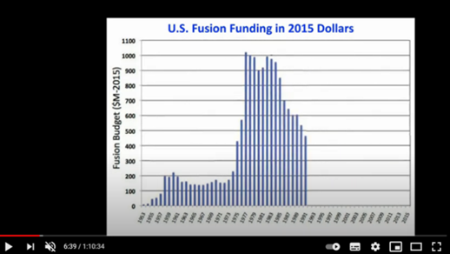
THE PRESUMPTION
OF PSEUDOSCIENCE
There is not a single scientific article in peer-reviewed journals that scientifically justifies the impossibility of cold nuclear fusion. There is no such thing. There is only information at the interview level, distributed by the media about the statements of scientists who have never been engaged in cold nuclear fusion, but were engaged in such fundamental and money-intensive areas of physics as thermonuclear fusion, stellar physics, the Big Bang theory, the origin of the Universe, the Large Hadron Collider.
The whole story: attributing cold nuclear fusion to pseudoscience is a story about money, not science. Just look at the schedule of funding for thermonuclear research in the United States 1953-1991. In fact, by 1989, funding for fusion research had halved from one billion dollars a year up to 450 million in 1991. There was something for the thermonuclearists to fight for!

Slide 20
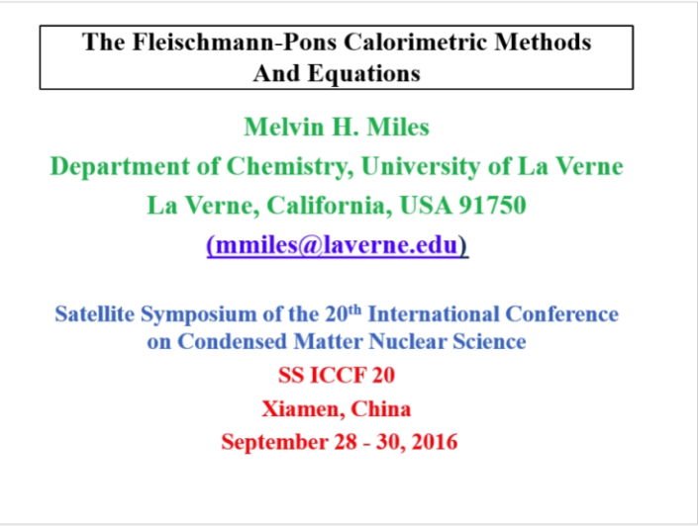
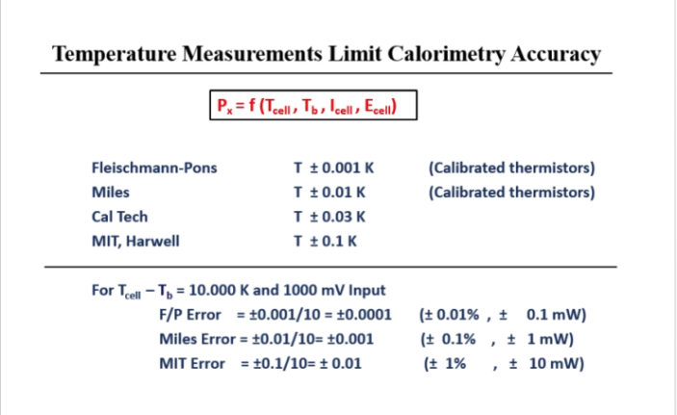
THE PRESUMPTION
OF PSEUDOSCIENCE
Back at the university, in the course of lectures "Measurement of Physical Parameters", we were taught that the verification of devices for measuring physical quantities must be carried out with a device that has an accuracy class higher than the device being verified. This rule has exactly the same relation to the verification of phenomena! Therefore, the heat tests at MIT and CAlTECH, which people like to refer to on the issue of the failure of cold fusion, are actually no tests at all. Compare the accuracy and error in measuring temperature and power with the experimental data of M. Fleishman and S. Pons, which are given in his report by Melvin Mills.
They differ by tens and thousands of times!

Slide 21

THE PRESUMPTION
OF PSEUDOSCIENCE
Regarding what "... if the main reason for the increased output energy yield is considered to be nuclear reactions involving deuterons, then the neutron yield would be significantly higher (by 11-14 orders of magnitude)." Here the calculation is simple: if 4 MJ per cm³ of the cathode of excess heat is released, then at least 4.29×10¹⁸ neutrons should be formed. If, at least, one neutron leaves the reaction zone, and does not give up its energy inside the cell from 2.45 MeV to room temperature, then there is no way to register so much excess heat. And if the emitted neutrons are registered, then the number of fusion reactions occurring in this case should be much greater than the minimum of neutrons and more tritium will be formed. Plus, knowing that the cross-section of the interaction of neutrons and helium-3 is incommensurably large compared to the cross-sections of other possible reactions of the products of d+d synthesis reactions (by about two orders of magnitude),
$${}_{ }^{3}{He}+n  T + p + 0,764 MeV$$
then it becomes clear that no one will be irradiated with neutrons and it is clear that such a ratio of the amount of registered tritium to the number of registered neutrons appears and where helium-4 is subsequently taken from. It appears as a result of a cascade of reactions of synthesis of products of d+d reactions, but this is already from the experiments of other researchers about helium-4. M. Fleishman and S. Pons do not say a word about this.
The "experts" are playing tricks with neutron irradiation. With such amounts of excess heat released, they should all turn into heat, transfer their energy to the materials and water of the electrolyte in the cell, and not carry away 75% of the energy from the reaction zone outside the reactor and irradiate the experimenters. Therefore, M. Fleishman and S. Pons recorded only a small part of the neutrons – heavy water, as is known, is a good moderator of neutrons.

Slide 22
THE PRESUMPTION
OF PSEUDOSCIENCE
From a scientific point of view, there is only one error in this article – it is the reduction of the amount of excess energy released to the volume of the palladium electrode used. In this case, the consumable component and energy source is deuterium. And, it would be logical to attribute the released excess amount of energy to the amount of deuterium absorbed by palladium and compare it with the assumed heat in nuclear fusion as a result of the d+d reaction, but, as mentioned above, the energy balance of this process should not be limited to the products of these reactions.
The magic terms: the Coulomb barrier, fusion, plasma, which sound from the lips of thermonuclear physicists, are fascinating. But I want to ask them: What is the relation of the temperature below 1000°C and the fourth aggregate state of matter-plasma have to do with the electrolysis process of Martin Fleischmann and Stanley Pons? Plasma is an ionized gas. Hydrogen ionization begins at 3,000 degrees Kelvin and by 10,000 degrees Kelvin, the hydrogen is completely ionized, that is, it is approximately 2,727°C -
- the beginning of ionization, and by 9,727°C-fully ionized hydrogen-plasma. Question: How can the description of the fourth aggregate state of a substance be applied to an ordinary gas? It's like comparing warm and transparent.
You can, of course, try to measure the distance to the Moon by determining the amount of dew that fell in the Sahara Desert at night, but what will be the result? Similarly, the results of cold nuclear fusion cannot be described and considered from the point of view of thermonuclear fusion. In this way, one can only deny the possibility of the cold nuclear fusion! And to present only one doubt about the possibility of conducting nuclear fusion reactions at such thermodynamic parameters. But nuclear physics does not say a word about the zero probability of nuclear reactions occurring at temperatures close to room temperatures. And this means only that these probabilities begin to increase when the room temperature rises to 1000 °C.

Slide 23
THE PRESUMPTION
OF PSEUDOSCIENCE
And here comes the age-old question: Cui prodest? - who benefits from this? Of course, the one who first starts shouting: "Stop the thief!". I don't want to hint at anyone, but they were the first to shout: "It can't be!" the physicists involved in thermonuclear fusion, and immediately began to tell their fairy tales and horror stories about plasma, neutrons and how it's all incomprehensible to the simple mind. And here they are, spending another couple of decades and a little more than a few tens of billions of dollars, in the end, almost fulfill the long-standing dream of humanity about endless and such "free", "clean" energy for all time. Only this reminds me of the bright communist future that we were so fervently promised in the USSR, and it turned out that this is just a horizon line that recedes when you strive for it, moving on the surface of the ball called planet Earth – an incentive in one word.
The biggest mistake of cold nuclear fusion, which the thermonuclearists "slipped" to us , is the inability to overcome the Coulomb barrier with equally charged hydrogen nuclei at low temperatures. I must disappoint them and all the "theorists" who have come running into cold nuclear fusion with their "astrolabes" and are trying to come up with something exotic to overcome this Coulomb barrier in the form of hydrino, dineutrino, dineutronium and etc. There are quite physical laws and phenomena that explain all the logic of the registered products of cold nuclear fusion, if you think a little and remember the university course of physics.
We must understand that cold nuclear fusion is a natural process that created, i.e. synthesized, the entire world around us, and this process occurs both in the bowels of the Sun and inside the Earth. It can't be any other way. And we'll all be absolute idiots if we can't take advantage of this discovery by two electrochemists!
Cui prodest?

Slide 24
THE PRESUMPTION
OF PSEUDOSCIENCE
Cold fusion is not pseudoscience, but only the assumption of pseudoscience for the sake of and in defense of the misguided and fearful responsibility of thermonuclear and large collider scientists, who have really turned modern physics into a profitable business for a narrow circle of people who only call themselves scientists.
The discovery of M. Fleishman and S. Pons gave a good pig to modern physicists, who are firmly on the cutting edge of science. They once famously skipped a small area of the possibility of nuclear fusion reactions at low temperatures and costs, and now they are at a great loss and will never admit this to anyone.
Therefore: Long live cold fusion! Oh, come on your thermonuclear! It's time to stop flushing a lot of money down the thermonuclear fusion toilet bowl. You give at least a drop of these funds for normal research of cold nuclear fusion and the creation of working power plants based on it! Someone, on whom it depends, make these overeager thermonuclear physicists work, as they should, with their heads, and not with their tongues. How much more time does it take to understand that thermonuclear fusion is a dead end, and the Sun - is not thermonuclear reactor? How long can you calm everyone with the unfulfilled (unrealizable) dream of thermonuclear energy? So, long live cold fusion! We must write this discovery in all school textbooks. And Stanley Pons should be awarded the Nobel Prize!

Slide 25
THE PRESUMPTION
OF PSEUDOSCIENCE
Cold nuclear fusion is a natural process that created, i.e. synthesized, the entire world around us, and this process occurs both in the bowels of the Sun and inside the Earth.
Cold fusion is not pseudoscience.
Long live cold fusion!
The Sun - is not thermonuclear reactor
We must write this discovery in all school textbooks!
Stanley Pons should be awarded the Nobel Prize!

Slide 26
THE PRESUMPTION
OF PSEUDOSCIENCE
Thanks for your attention

